Slide 1
BITNG PROJECT UPDATE
Carl Demolder
Date 11/23/2020

Slide 2
Outline
Progress to date
Shriner’s project
Schedule
Gantt Chart update
Path forward

Slide 3
PROGRESS TO DATE

Slide 4
Progress from last week
Finals
LP ECG
Firmware development

Slide 5
SHRINER’S PROJECT

Slide 6
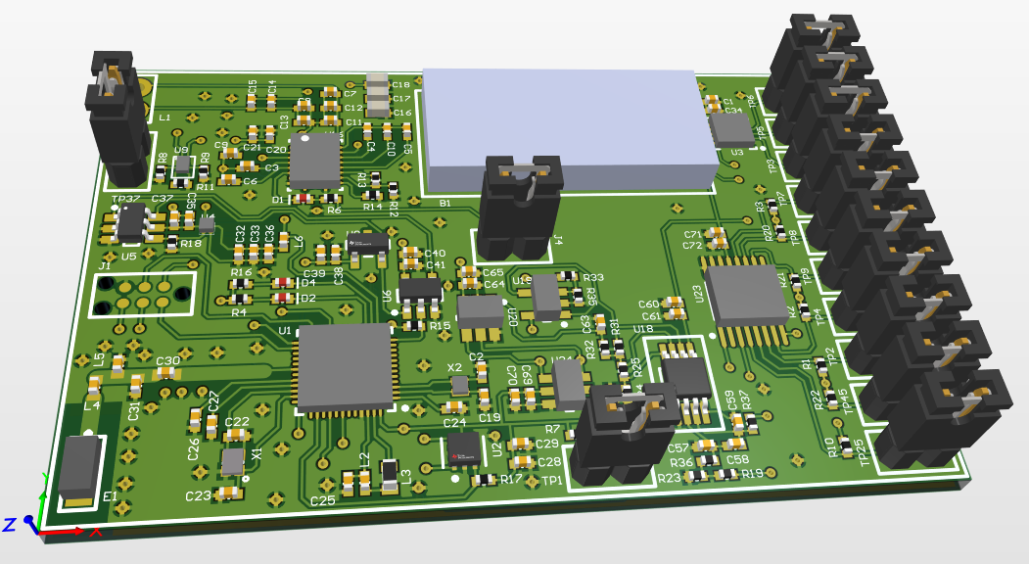
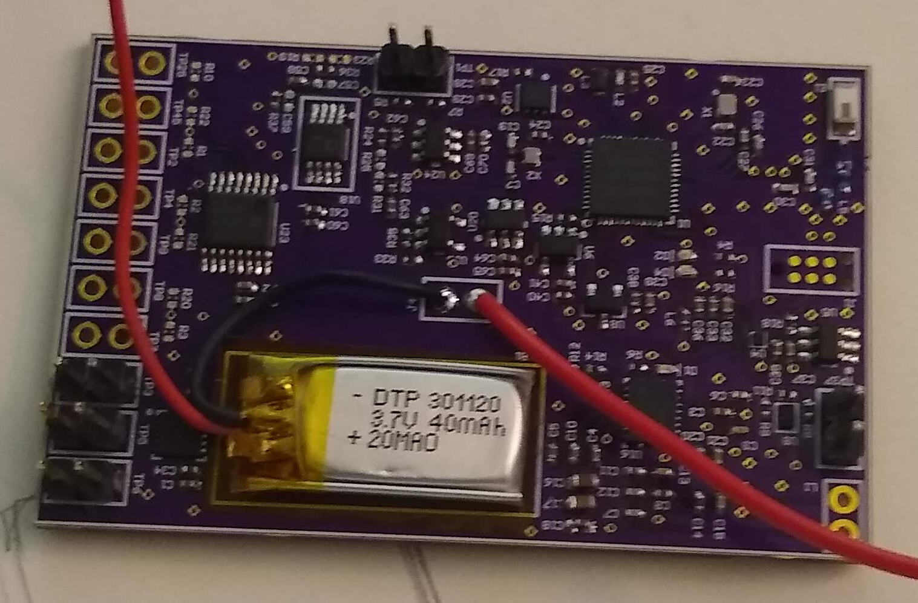
PCB design
PCB: Arrived
Stencil: Arrived
Digikey: Arrived
Assembly: Complete
Hardware Debug: Completed
Programming Check: TO DO

Slide 7
LP ECG PROJECT

Slide 8
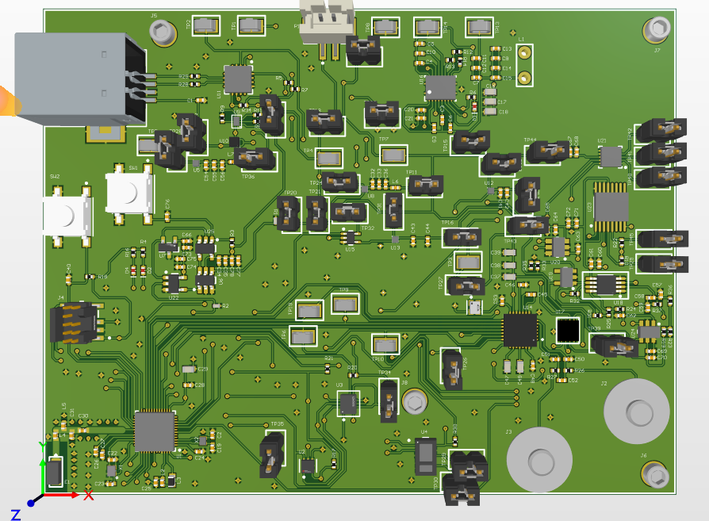
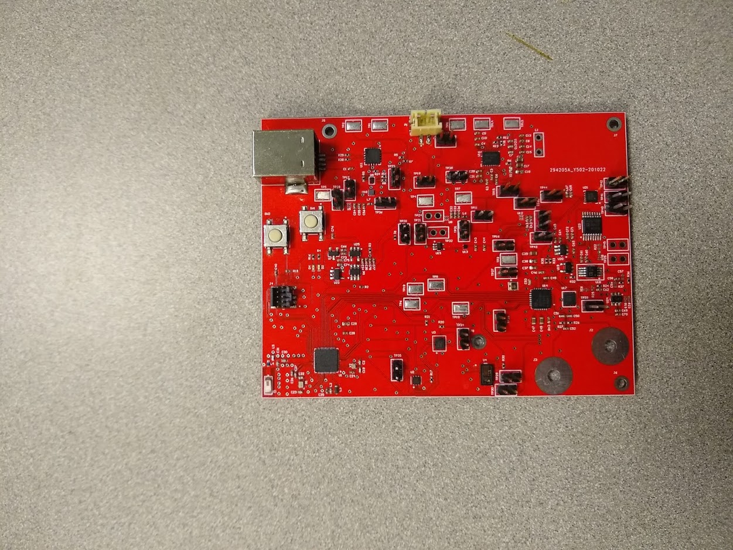
PCB design
PCB: Arrived
Stencil: Arrived
Digikey: Arrived
Assembly: Completed
Hardware Debug: Completed
Programming Check: TO DO

Slide 9
Firmware
ECG
MAX30003
Drivers
Optimization
FRAM
CY15B108QI
Drivers
Optimization
NRF52
BLE
Power Optimization
RTC

Slide 10
STRAIN SENSOR

Slide 11
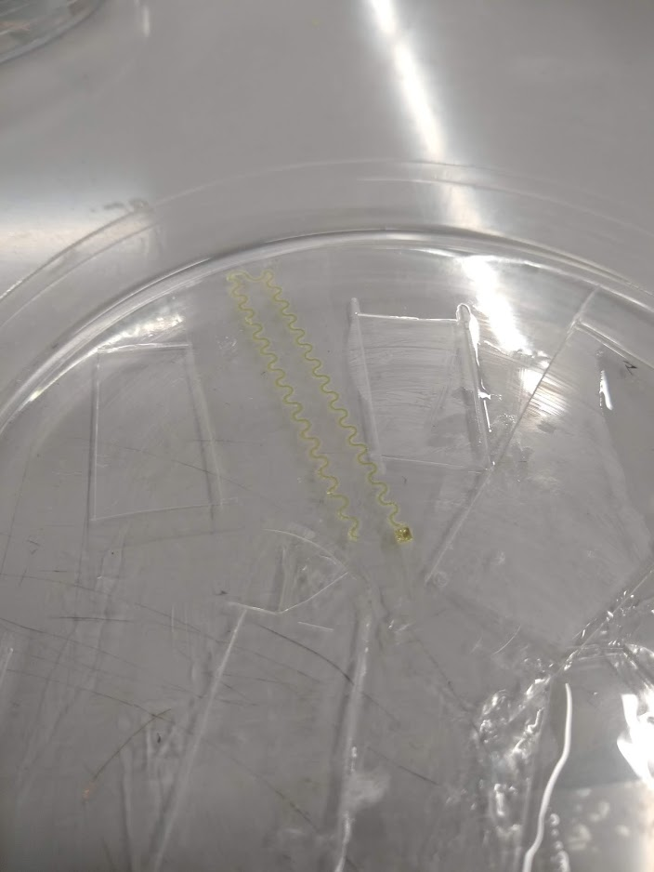
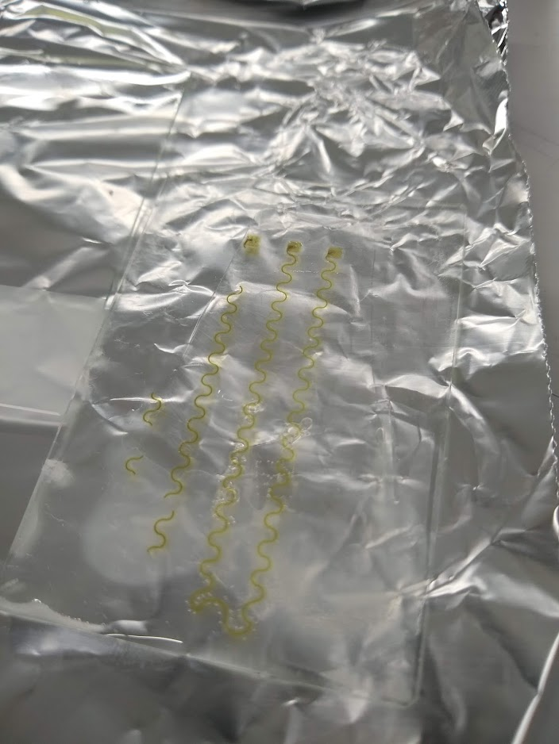
Strain Sensor: Round #1
PDMA: Finished
PI: Finished
AG NW: Finished
PDMS: Finished
ASSEMBLY: FAILED
ENCAPSULATION: FAILED
Characterization: FAILED
Not enough nano-wires
Broken pads

Slide 12
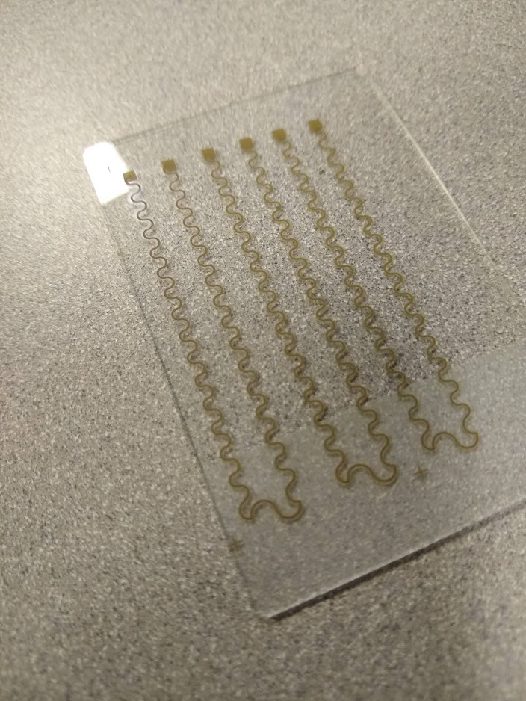
Strain Sensor: Round #2
PDMA: Finished
PI: Finished
AG NW: Finished
Conductivity Test: FAILED
PDMS: TO-DO
ASSEMBLY: TO-DO
ENCAPSULATION: TO-DO
Characterization: TO-DO

Slide 13
PATH FORWARD

Slide 14
Path forward (11/23/20 – 11/30/20)
Shriner’s Project:
Sensor manufacturing:
Strain sensors (2X)
Conductivity test and characterization
LP ECG:
Firmware development

Slide 15
SCHEDULE

Slide 16
Schedule Gantt chart
Task | 11/16-11/23 | 11/23-11/30 | 11/30-12/07 | 12/07-12/14 | 12/14-12/21 | 12/21-12/28 | 12/28-1/4
LOW POWER ECG
-PCB ASSEMBLY
-HARDWARE DEBUGGING
-FIRMWARE DEVELOPMENT
NEUROMOTOR PEDIATRIC WEARABLE
-LITERATURE REVIEW
-PCB ASSEMBLY
-HARDWARE DEBUGGING
-FIRMWARE DEVELOPMENT
-PRESSURE SENSOR MANUFACTURING
-STRAIN SENSOR MANUFACTURING
LEGEND
FINSHED
TO-DO

Slide 17
APPENDIX

Slide 18
CAPACITANCE SENSOR

Slide 19
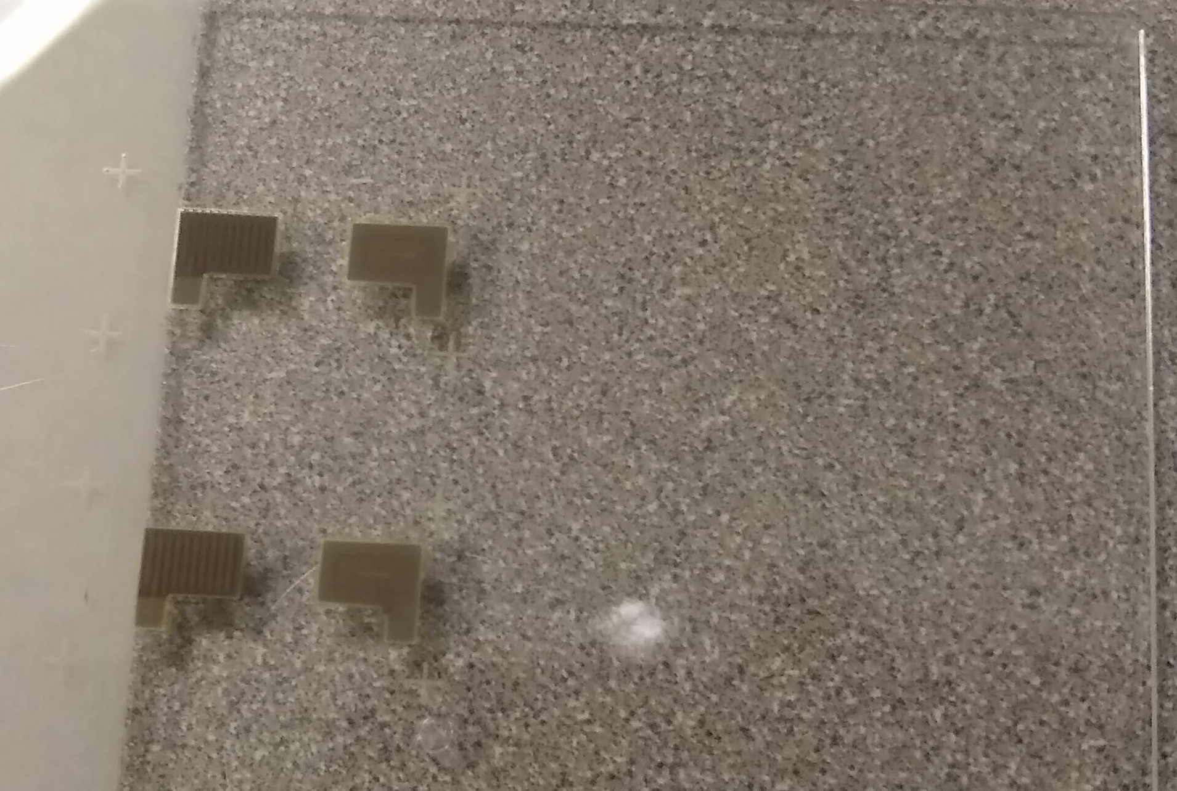
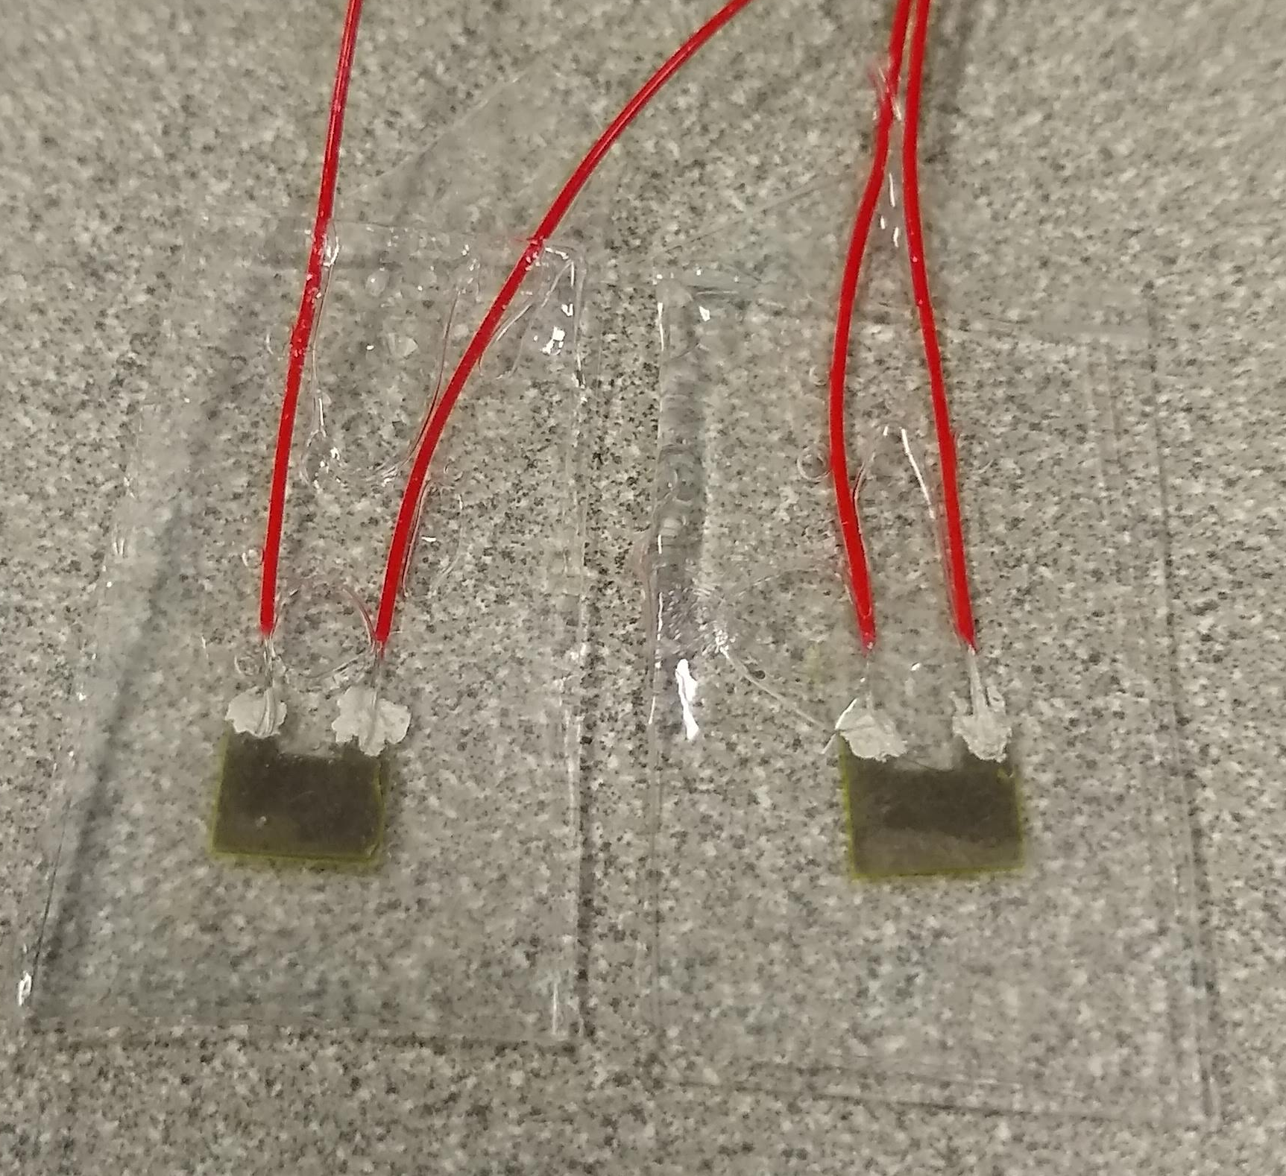
Capacitance sensor
PDMA: Finished
PI: Finished
AG: Finished
PDMS: Finished
ASSEMBLY: Finished
ENCAPSULATION: Finished
Characterization: TO-DO

Slide 20
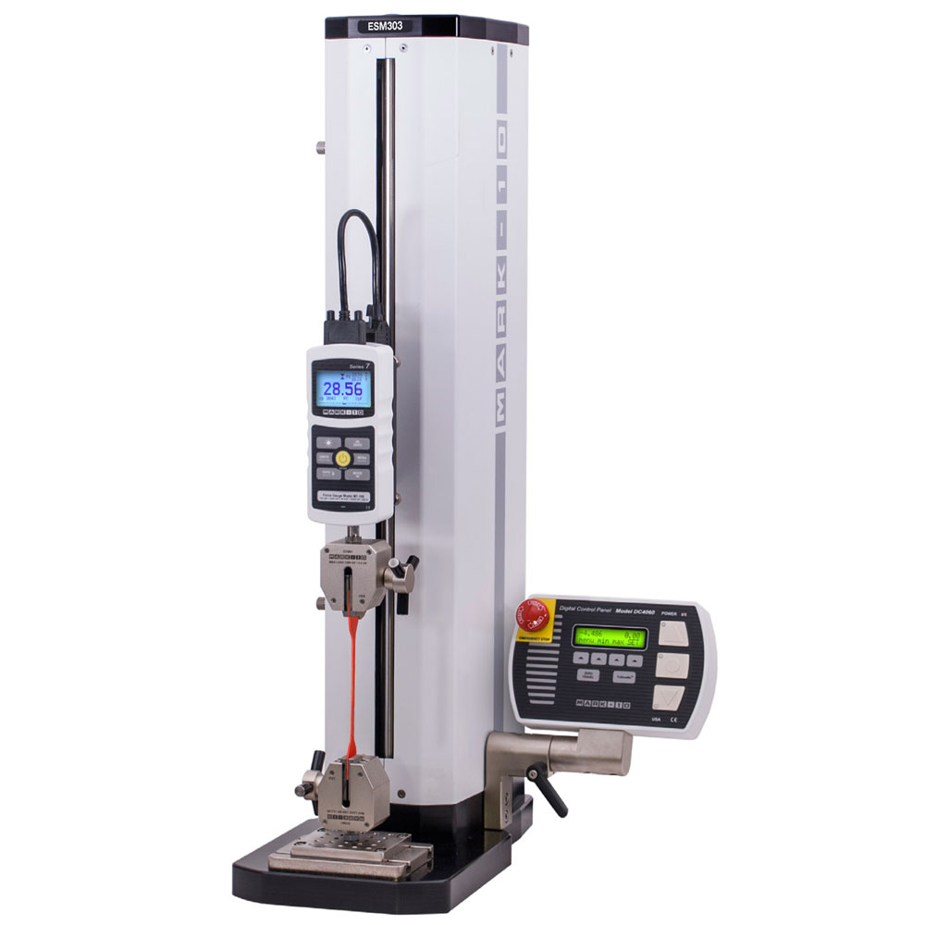
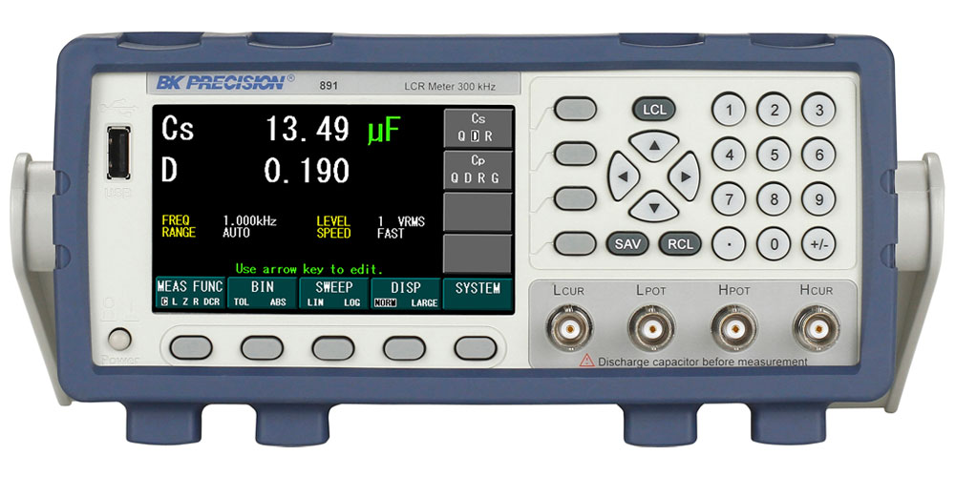
Capacitance/Force characterization
Mark-10 Force Gauge
Automated testing characterization

Slide 21
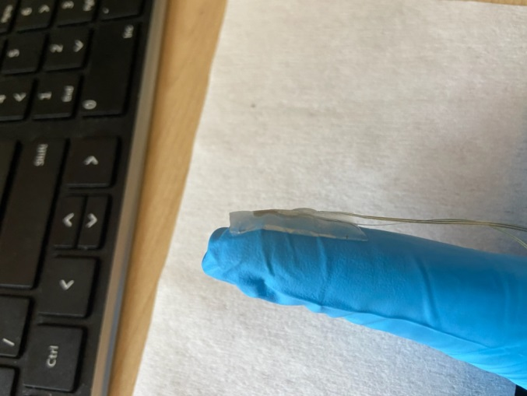
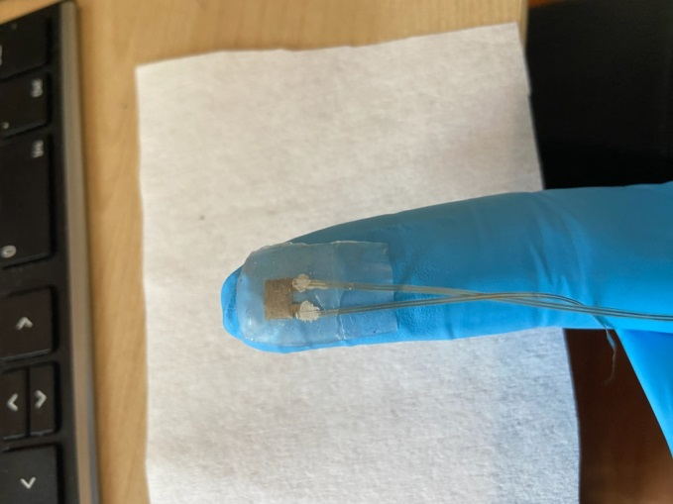
Capacitor sensors
Data collected from Robby
Max capacitance change
20% ~ 10 pF
Increasing pressure

Slide 22
Capacitor sensors
Data collected from Robby
Sensitivity: 0.133 pF/kPa
Pressure threshold > 0.5 kPa
example data
capacitance change
percent change

Slide 23
Capacitance sensor design
Capacitor area (prior art): 3mm x 5mm
Initial capacitance: 52 pF
Sensitivity: 0.133 pF/ kPa
 | Low threshold | High Threshold
Target force (g/N) | 4 / 0.0392 | 180 / 1.764
Target pressure (kPa) | 1.568 | 70.56
Capacitance change (pF/%) | 0.2085 / 0.4 | 9.384 / 18
CDC units | 910 | 40,999

Slide 24
IRB PROPOSAL

Slide 25
IRB proposal
Initial Draft X01:
Draft sent to IRB Review Board on 10/13
Revision X02:
Draft sent to IRB Review Board on 10/26
Revision X03:
Draft sent to IRB Review Board on 10/29
Revision X04:
Draft sent to IRB Review Board on 11/2

Slide 26
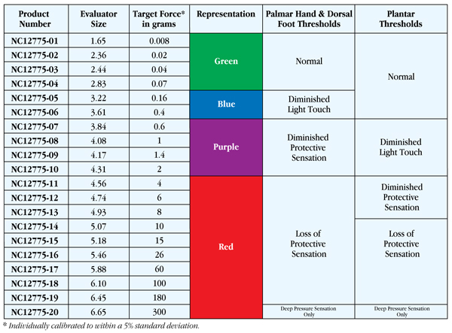
Semmes Weinstein scale
4-180 grams of target force

Slide 27

Block diagram-motherboard
INDUCTIVE
WIRELESS
CHARGING
MOTHERBOARD
Wired Digital Communication
BMS
NRF52832
SENSORY
SENSING CIRCUIT
SENSORY
SENSING
WEARABLE
LIPO
BATTERY
FEEDBACK
ARMBAND

Slide 28
Block diagram-sensory sensing
SENSORY
SENSING
SENSOR GLOVE
PRESSURE
SENSORS [3X]
TEMPERATURE
SENSOR [3X]
GRASP STRAIN
SENSOR [1X]
FINGER STRAIN
SENSOR [3X]
CAPACITIVE
PRESSURE
SENSORS [3X]
RESISTANCE
TEMPERATURE
SENSORS [3X]
RESISTANCE
STRAIN
SENSORS [4X]
CAPACTIVE
SENSING
CIRCUIT [3X]
MOTHERBOARD
RESISTIVE
SENSING
CIRCUIT [7X]
WIRED DIGITAL COMMUNICATION [4 LINES]
NRF52832

Slide 29
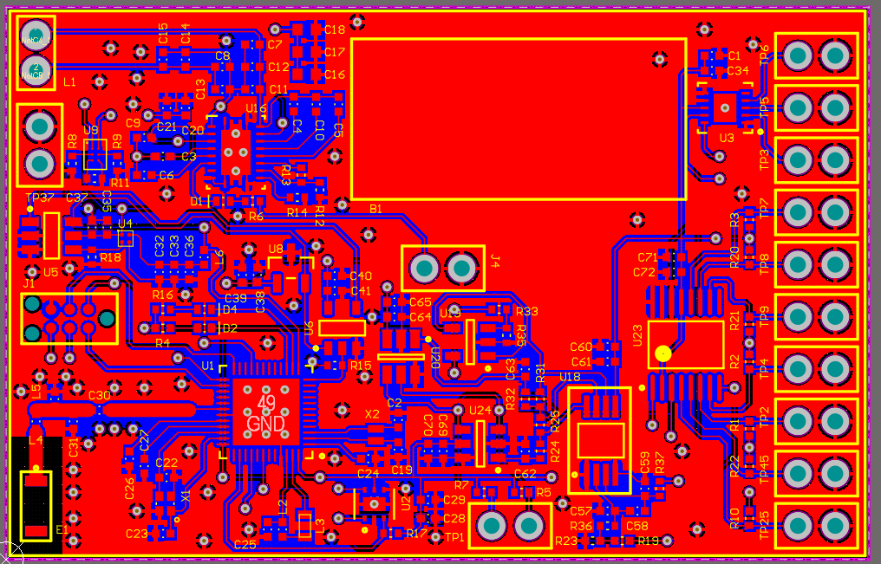
PCB design
~60mm x ~40mm

Slide 30
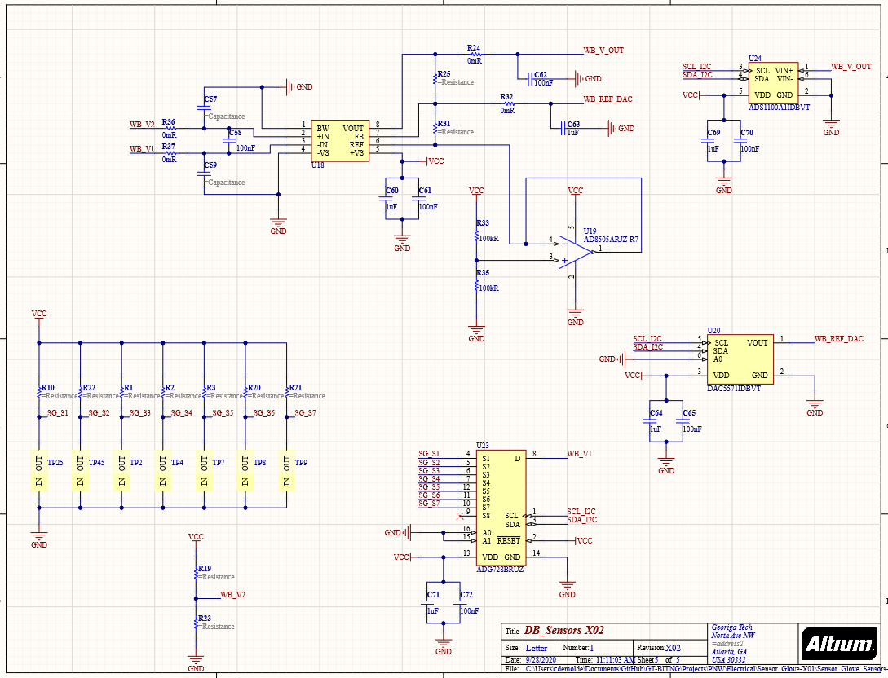
Resistive sensing circuit
Up to 8 resistance sensors

Slide 31
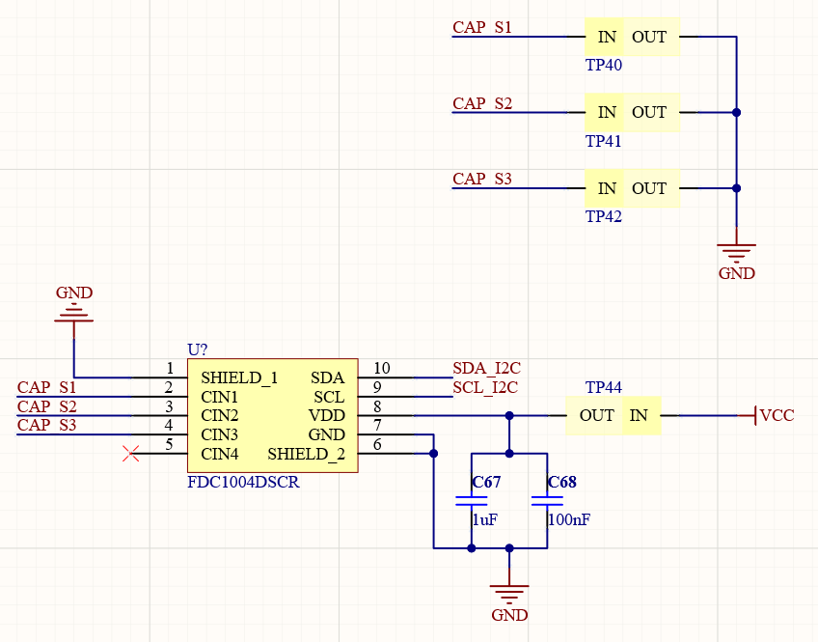
Capacitive sensing circuit
Up to 4 Capacitance sensors**

Slide 32
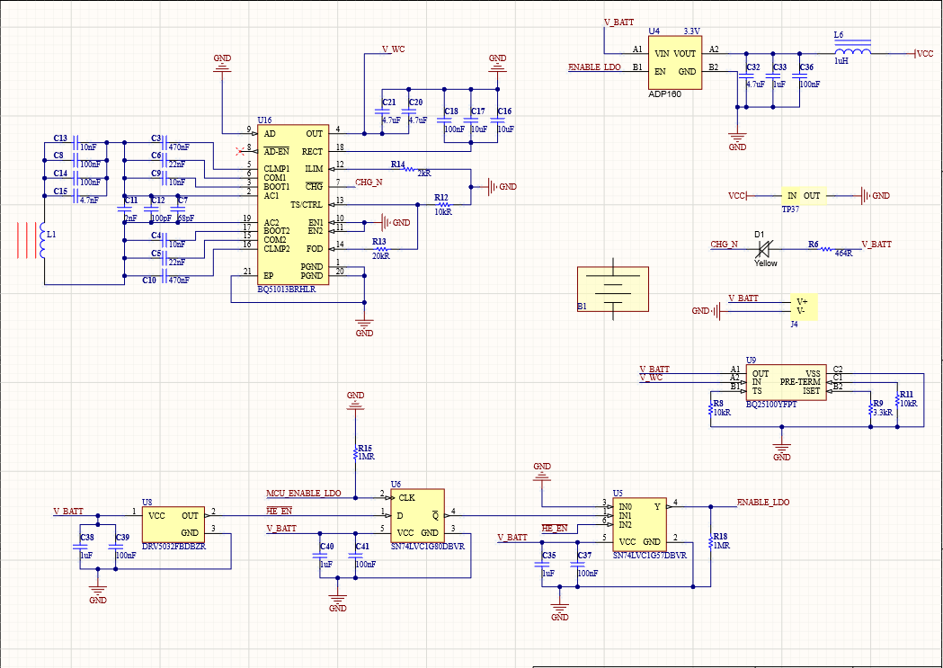
Power circuit

Slide 33
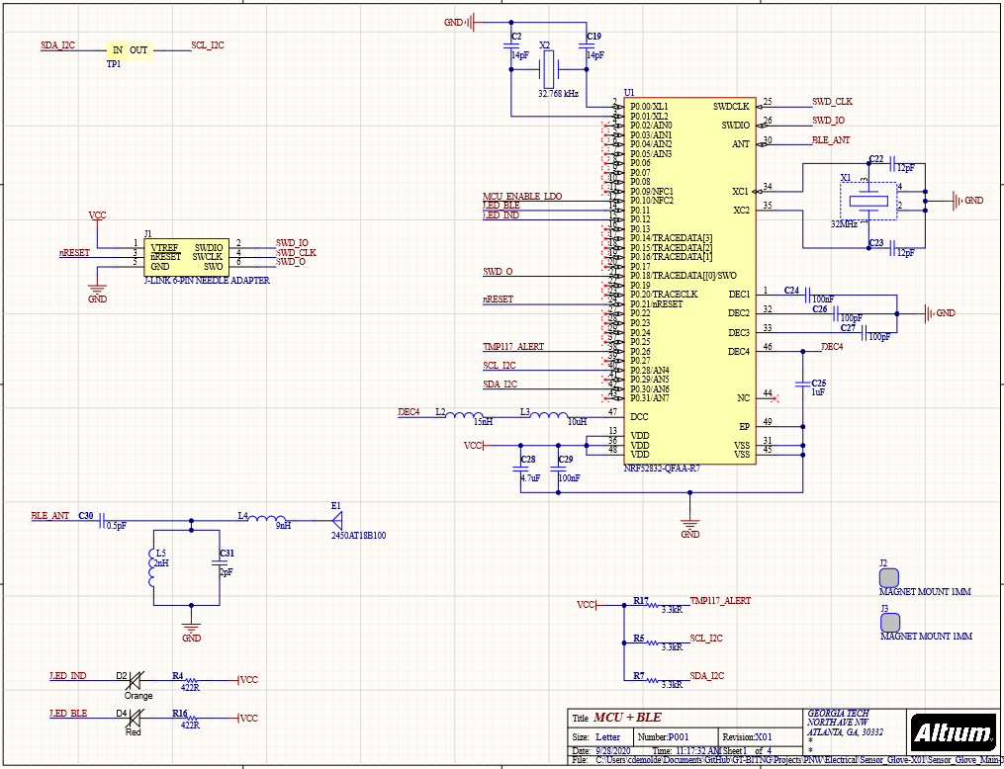
MCU circuit

Slide 34
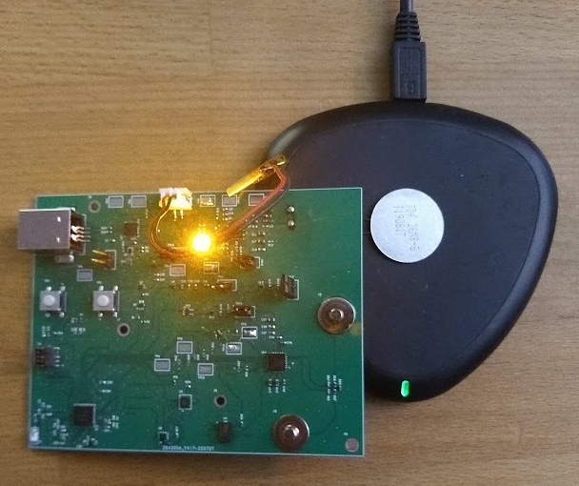
Wireless charging: Inductive
Hardware
Old wireless charging coil:
TDK 45-15F5-G (48.2mm x 32.2mm x 1.0mm)
Current inductive coil:
WR222230-26M8-G (22 mm x 22mm x 0.87 mm)
TRANSMITTER
RECEIVER
CIRCUITRY
FOOTPRINT:
15mm x 15mm
RECEIVER COIL

Slide 35
Wireless charging: RF
RF Harvesting
Battery and battery-less electronics
7 mA continuous @ 0.5 meter
Companies contacted for development kit:
Humavox
Still waiting for a response
Energous
In conversation to receive 10 units of their receivers
Powercast
Digikey [PURCHASED]
Transmitter (TX91503 $99.00)
Battery-less receiver module (P2110B $48.33)
Battery charging receiver module (P1110B $32.00)
Development kit (P1110-EVAL-PS $420.00)

Slide 36
HOUSEKEEPING

Slide 37
Housekeeping
Electronics inventory:
Google spreadsheet listing what is in stock at the lab
Resistors, capacitors, inductors, ICs, etc…
Reduce wait time to purchase parts

Slide 38
Electronics development: schematic
Schematic generation
nRF52 with supporting circuitry (2 hours)
BLE antenna and impedance matching circuit (2 hours)
Wireless charging (5 hours)
Lithium battery charging (2 hours)
UI interaction (1 hour)
USB charging (2 hours)
Biosensors: temperature, IMU, ECG (4 hours)
Test points, connectors, jumpers (2 hours)
Estimated time: 20 hours
Actual time spent: 22 hours
*Not in scope for current phase of development.

Slide 39
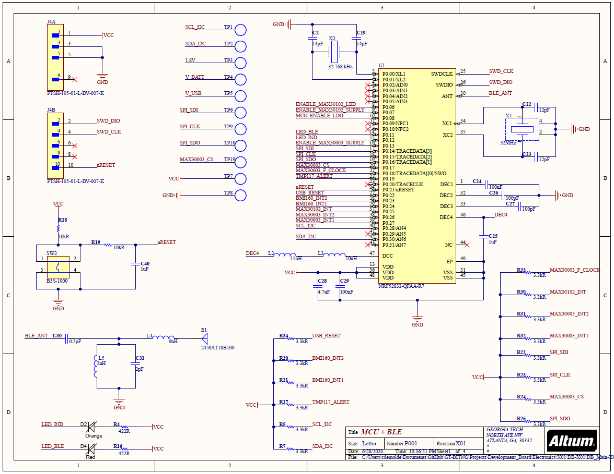
Progress to date: 6/28/2020

Slide 40
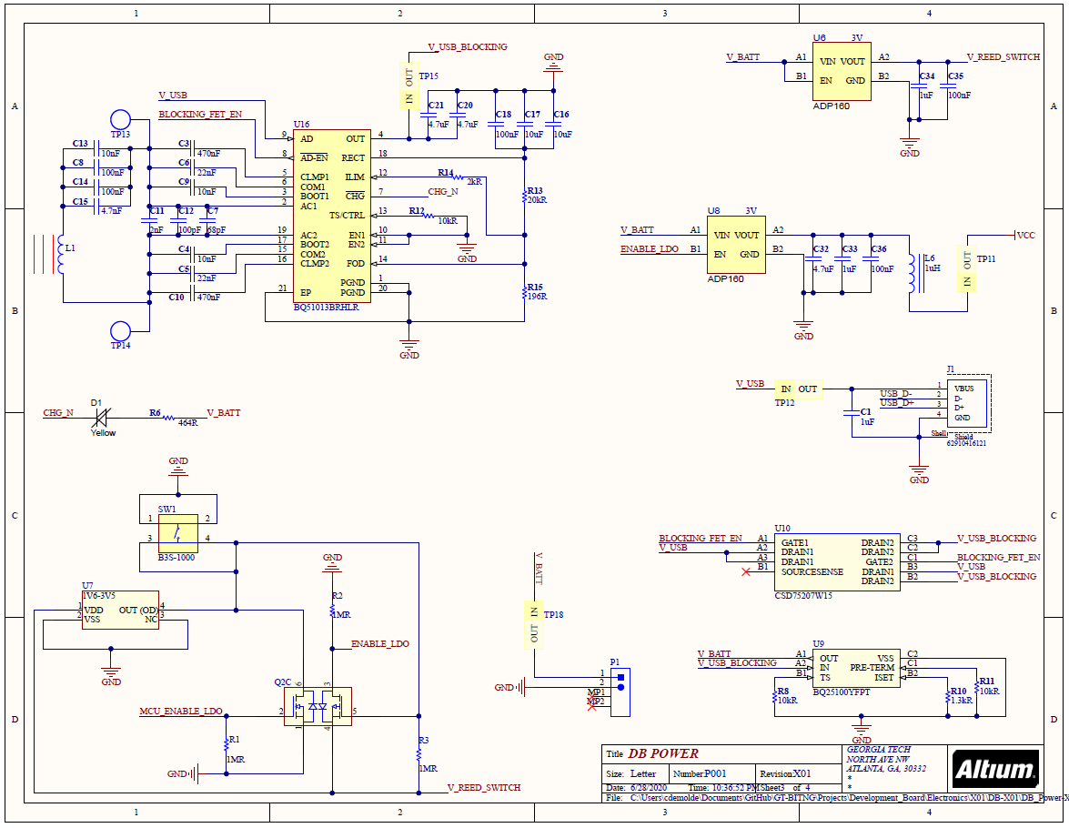
Progress to date: 6/28/2020

Slide 41
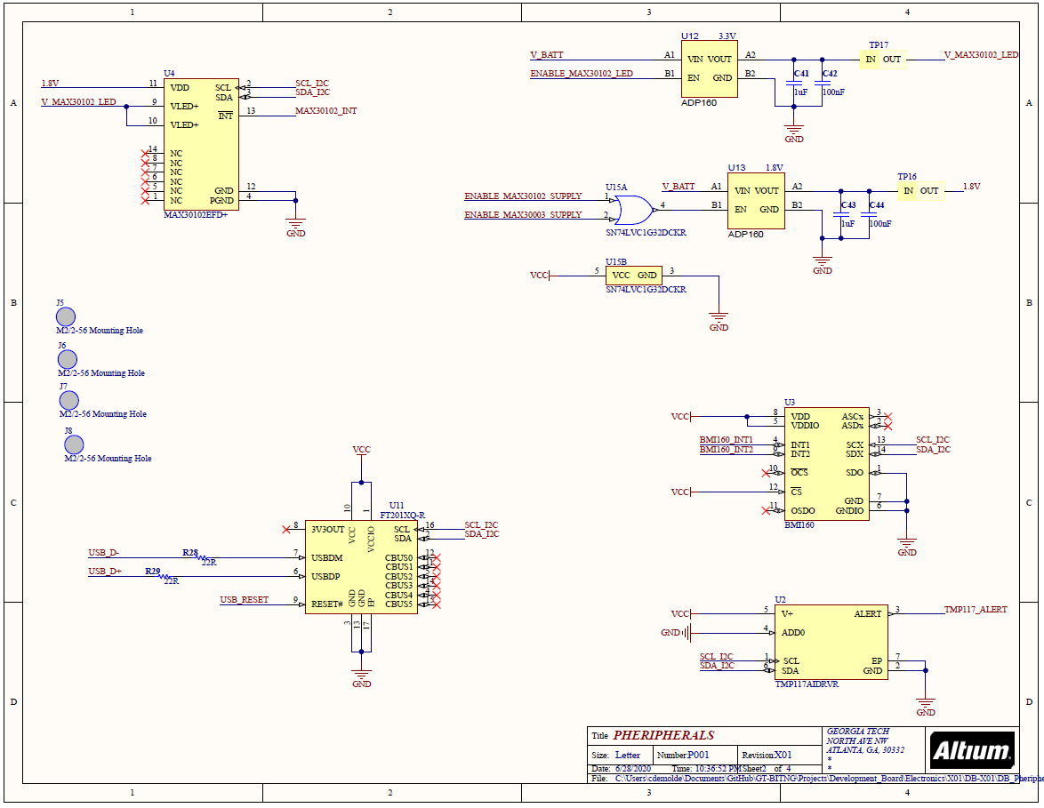
Progress to date: 6/28/2020

Slide 42
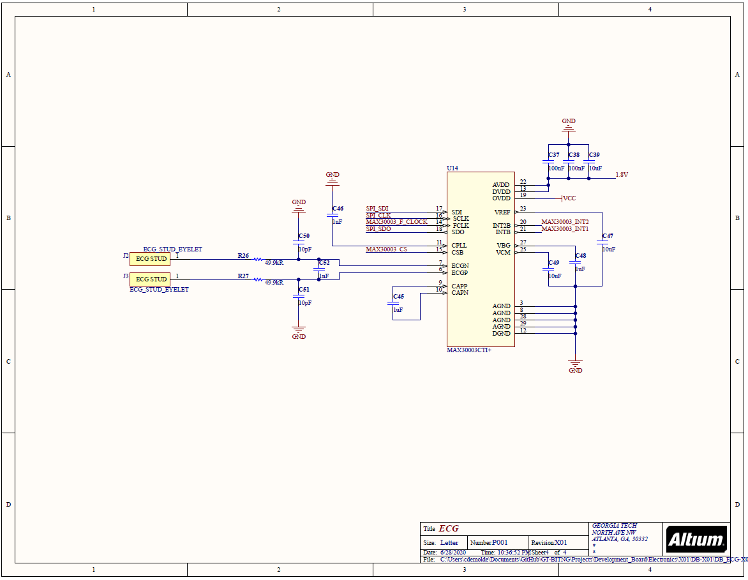
Progress to date: 6/28/2020

Slide 43
Electronics development: PCB design
PCB design
Major component layout (2 hours)
BLE antenna and impedance matching circuit (3 hours)
Wireless charging (2 hours)
Lithium battery charging (1 hours)
Overall board construction(1 hour)
USB charging (2 hours)
Biosensors: temperature, IMU, ECG (3 hours)
Test points, connectors, jumpers (1 hours)
Gerber file generation (2 hours)
BOM generation (2 hours)
Estimated time: 16 hours
Actual time spent: 20 hours

Slide 44
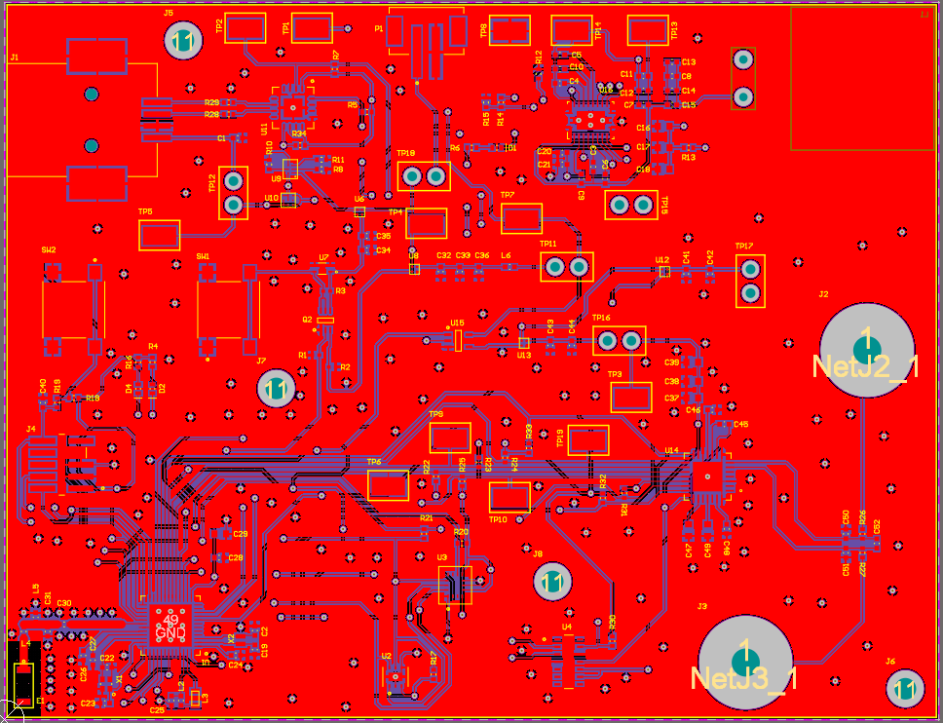
Progress to date: 6/28/2020

Slide 45
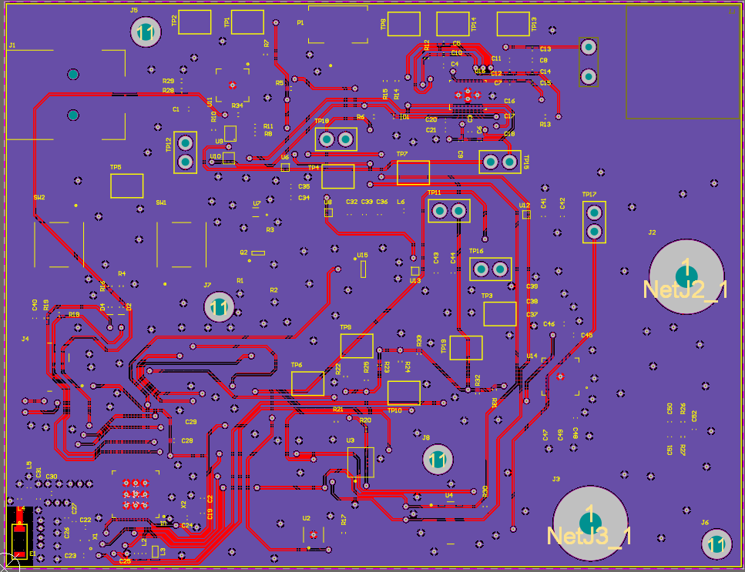
Progress to date: 6/28/2020

Slide 46
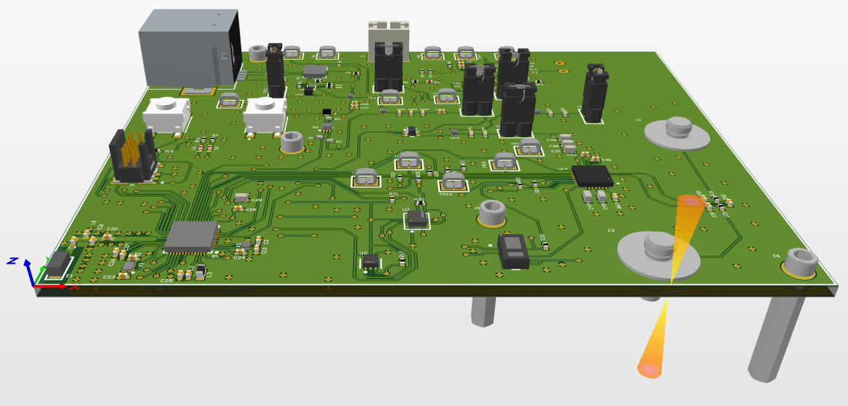
Progress to date: 6/28/2020

Slide 47
PCB manufacturing specifications
Dimensions: 99.568 x 76.454 mm
Layers: 2
Minimum trace/space: 6 mil
Minimum hole size: 12 mil
Thickness: 1.6mm
Solder mask: Green
Surface finish: HASL with lead
Copper weight: 1 oz
Material type: FR4

Slide 48
PCA quote
PCB Manufacturing:
Price: $20
Manufacturer: PCBMinions
Lead time: 4 days
BOM:
Price: ~$289.63
Board Quantity: 3
Supplier: Digikey/Mouser
Lead time: 1-5 days
Stencil:
Price: ~46.25
Supplier: OSH Stencil
Lead time: 5 days

Slide 49
Firmware development
Firmware
Project and BLE stack (5 hours)
Sensor drivers
I²C driver (4 hours)
Temperature driver (2 hours)
ECG driver (6 hours)
IMU driver (3 hours)
USB & RTT data logging (5 hours)
RTT data logging (2 hours)
USB data logging (3 hours)
DAQ slave protocol (1 hour)

Slide 50
PROJECT MANAGEMENT

Slide 51
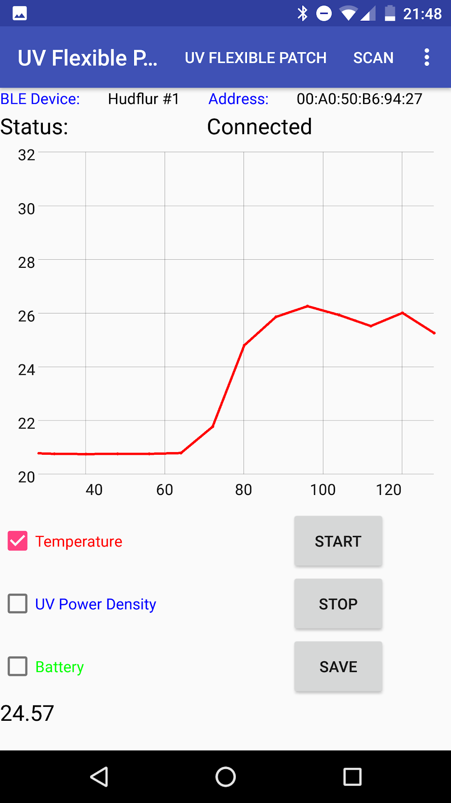
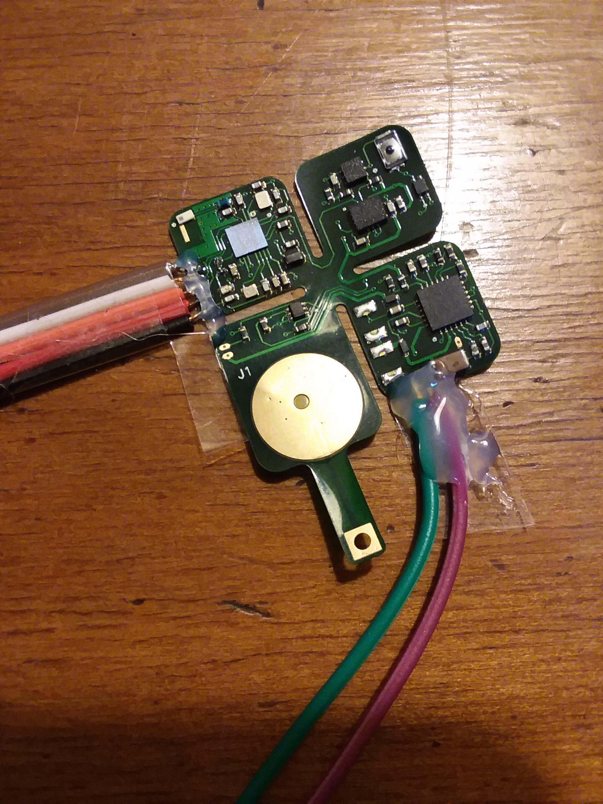

Introduction
Purpose:
Design a development board to test the functionality of different ‘plug-in-play’ sensors, wireless charging, and BLE communication. In the future, these sensors will be used in different combinations to build wearable devices.

Slide 52
Project management
Project status updates will be emailed to YSK and Dr. Yeo on a weekly basis by Monday morning (ET)
A rolling PowerPoint presentation will be used to document results and act as a final report
Each progress update will be timestamped, and the revision number will be incremented
Primary form of communication: email
Zoom/phone calls can not be conducted from 12 PM – 8 PM ET, Monday – Friday (due to my work schedule)
Project documents and resource will be available through my Github repository
Time commitment: average 10 hours/week

Slide 53
Project requirements
Requirements:
Design a development board PCB to demonstrate capabilities to connect to different bio-sensors
Development board must include the following functionality:
Wireless and USB charging
Battery management
USB data communication and logging
Use the nRF52832 MCU/SoC
BLE connectivity and BLE GATT database
Temperature sensing
Motion sensing
ECG
Capability to add more sensors in the future

Slide 54

Schedule overview
Electronics development
Date range: 6/1–7/31
Estimated hours to produce hardware: 49 hours
Estimated hours to test/debug/qualify hardware: TBD
Firmware development
Date range: 6/28-7/31
Estimated hours to produce firmware: 33 hours
Estimated hours to test/debug/qualify firmware: TBD
Any questions about the scope?
Let me know!

Slide 55
PROJECT PROPOSAL

Slide 56
Firmware development
Firmware
Project and BLE stack (5 hours)
Sensor drivers
I²C driver (4 hours)
Temperature driver (2 hours)
ECG driver (6 hours)
IMU driver (3 hours)
USB & RTT data logging (5 hours)
Future development*
BLE GATT database and data transfer (25 hours)*
Sensors: fuel gauge, H.R./Sp0₂ (8 hours)*
Data storage: EEPROM, Flash (8 hours)*
*Not in scope for current phase of development.

Slide 57
Hardware testing
Firmware testing
Firmware sensor functionality testing (8 hours)
Hardware testing
Overall hardware testing (5 hours)
Hardware sensor functionality testing (8 hours)
Future development*
Power consumption*
BLE range and connection testing*
*Not in scope for current phase of development.

Slide 58
Block diagram
PHERIPHERAL SENSORS
ANDROID PHONE**
PYTHON DATA LOGGER
IMU
BLE
BLE TX/RX
TEMPERATURE
USB
RF
SERIAL TO USB CONVERTER
SERIAL
MCU/SoC
SERIAL
ECG
POWER
OUT OF SCOPE
LIPO BATTERY
POWER
BMS
HR/Sp0₂**
POWER
BATTERY GAUGE**
WIRELESS
CHARGING COIL
POWER
WIRELESS CHARGING CIRCUITRY
**Not in scope for current phase of development.

Slide 59
PROJECT PROPOSAL: POWER CONSUMPTION TESTING
OUT OF SCOPE

Slide 60
Power consumption testing [TBD]
OUT OF SCOPE
Objective: Measure the power consumption of various sensors during operation, idle, and sleep mode
Log battery current and voltage at a defined sampling rate
Produce a power consumption model to determine battery life

Slide 61
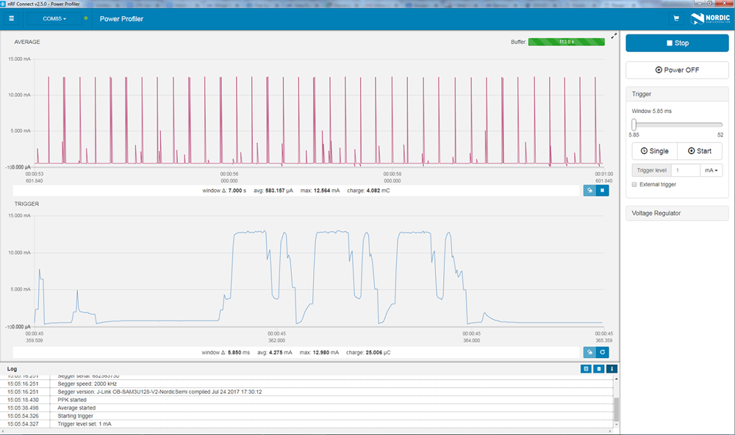
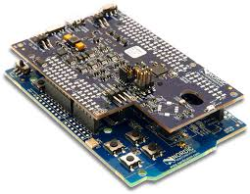
Power consumption testing [TBD]
OUT OF SCOPE
Nordic power profiler
Nano-amp resolution, fast sampling rate
See spikes of BLE transmission

Slide 62
Schedule flowchart: hardware
PROJECT
PROPOSAL
SCHEMATIC
GENERATION
PCB COMPONENT
LAYOUT
6/1–6/7; ~5 Hours
6/7–6/14; ~20 Hours
6/14–6/17; ~3 Hours
HARDWARE
TESTING*
FULL TURNKEY
PCB MFG.
PCB ROUTING
& MFG. FILE GENERATION
7/12–7/19; 5 Hours
6/28–7/12; ~4 Hours
6/17–6/28; ~12 Hours
OUT OF SCOPE
SENSOR FUNCTIONALITY TESTING*¹
POWER CONSUMPTION TESTING*²
BLE RANGE & CONNECTION
TESTING*²
7/19–7/31; 8 Hours
8/23–9/6; TBD
8/23–9/06; TBD
*Physical hardware needed to debug and perform testing.
¹Hardware functionality test of the sensors will be performed. Performance and accuracy will not be qualified. ²Not in scope for current phase of development.

Slide 63
Schedule flowchart: firmware
PROJECT
PROPOSAL
PROJECT STACK
ORGANIZATION
SENSOR
DRIVERS
7/1–6/7; ~5 Hours
6/28–7/2; ~5 Hours
7/2–7/12; ~15 Hours
OUT OF SCOPE
BLE GATT
DATABASE²
SENSOR FUNCTIONALITY TESTING*¹
SERIAL & RTT DATA LOGGING W/ PYTHON
8/16–8/23; ~25 Hours
7/19–7/31; ~8 Hours
7/5–7/12; ~5 Hours
POWER
CONSUMPTION
TESTING*^{1,2}
8/23–9/6; TBD
*Physical hardware needed to debug and perform testing.
¹Firmware functionality test of the sensors will be performed. Performance and accuracy will not be qualified.
²Not in scope for current phase of development.

Slide 64
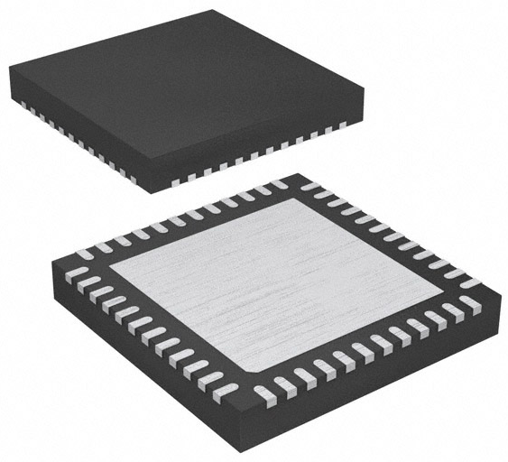
Component selection: MCU/BLE
MCU/BLE: nRF52832
6 pin, 2.00 mm x 2.00 mm, WSON-6
±0.1°C from -20°C to +50°C
2.4 GHz BLE
Power = 4 dBm
Sensitivity = -96 dBm
RAM = 64 kB, flash = 512 kB
Serial interfaces: I²C, UART, SPI
Supply voltage: 1.7V ~ 3.6V
$5.46 [X1], 1490-1067-1-ND, LINK
nRF52832

Slide 65
Component selection: clocks
HF clock: US3200005Z
4 pin, 1.60 mm x 1.20 mm, 4-SMD
32.00 MHz, 8 pF, ±10 ppm
$1.45 [X1], US3200005ZCT-ND, LINK
LF clock: ECX-1210
1210 package, 1.20 mm x 1.00 mm, 2-SMD
32.7680 kHz, 9 pF, ±20 ppm
$1.52 [X1], XC2283CT-ND, LINK
US3200005Z
ECX-1210

Slide 66
Component selection: USB/Serial
USB connector: 62910416121
4 pin, 16.00 mm x 10.62 mm, SMT type B
USB TYPE-B, USB 2.0, right angle
$3.83 [X1], 732-3152-1-ND, LINK
USB/I²C converter: FTDI FT201XQ-R
16 pin, 4.0 mm x 4.0 mm, 16-QFN
USB to I²C converter
3.4 Mbit/s
Low power consumption (8 mA)
$2.04 [X1], 768-1131-1-ND, LINK
62910416121
FT201XQ-R

Slide 67
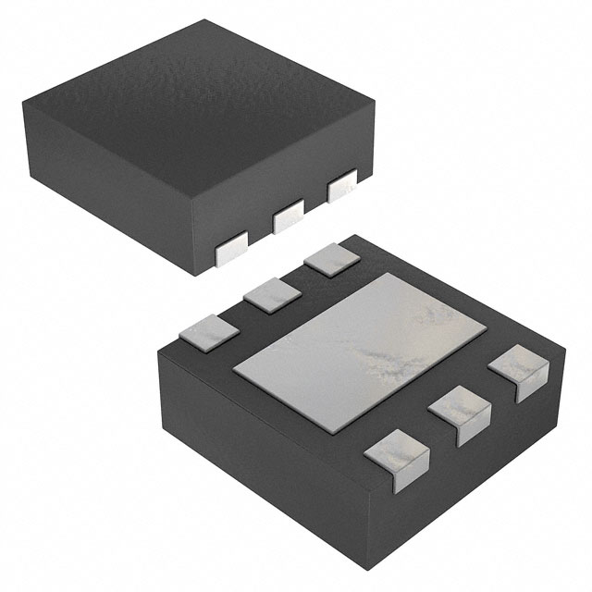
Component selection: Bio-sensors
Temperature: TI TMP117
6 pin, 2.00 mm x 2.00 mm, WSON-6
±0.1°C from -20°C to +50°C
16-bit resolution: 0.0078 °C, I²C
$8.02 [X1], 296-51834-1-ND, LINK
IMU: TI BQ27621-G1
14 pin, 2.5 mm x 3.0 mm, 14-LGA
I²C communication
9-axis, 16-bit resolution
Full operation mode = 925 uA
$4.98 [X1], 828-1057-1-ND, LINK
TMP117
BMI160

Slide 68
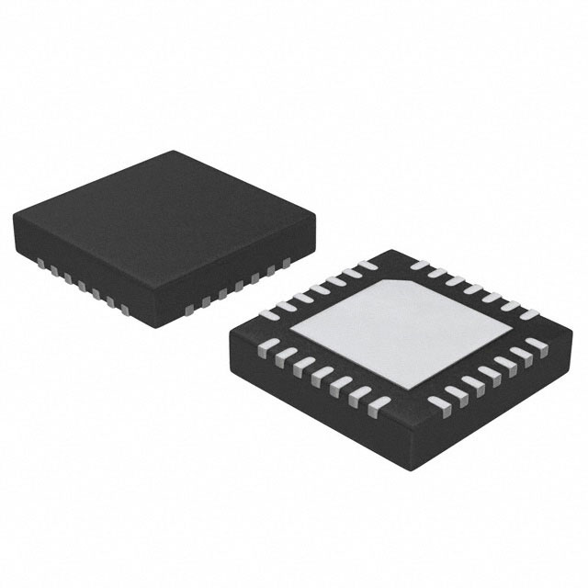
Component selection: Bio-sensors
OUT OF SCOPE
H.R. & Sp0₂: MAX30102
14 pin, 5.6 mm x 3.3 mm, 14-OESIP
Pulse oximetry and heart-rate
Temperature compensation, I²C
$9.51 [X1], MAX30102EFD+-ND, LINK
ECG: MAX30003
28 pin, 5.0 mm x 5.0 mm, 28-TQFN
SPI communication
15.5-bit resolution
Ultra-low power, single-channel integrated
$8.21 [X1], MAX30003CTI+-ND, LINK
MAX30102
MAX30003

Slide 69
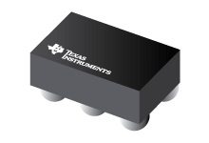
Component selection: wireless charging
Wireless charging IC: TI BQ51003
28 pin, 1.90 mm x 3.00 mm
QI v1.2 communication protocol
93% AC-DC efficiency
$3.00 [X1], 296-39952-1-ND, LINK
LiPo battery charger IC: TI BQ25100
6 pin, 1.6 mm x 0.90 mm, 4.2V 1 cell
1% Charge voltage accuracy
10 mA to 250 mA charging current
$2.24 [X1], 296-38373-1-ND, LINK
BQ51003
BQ25100

Slide 70
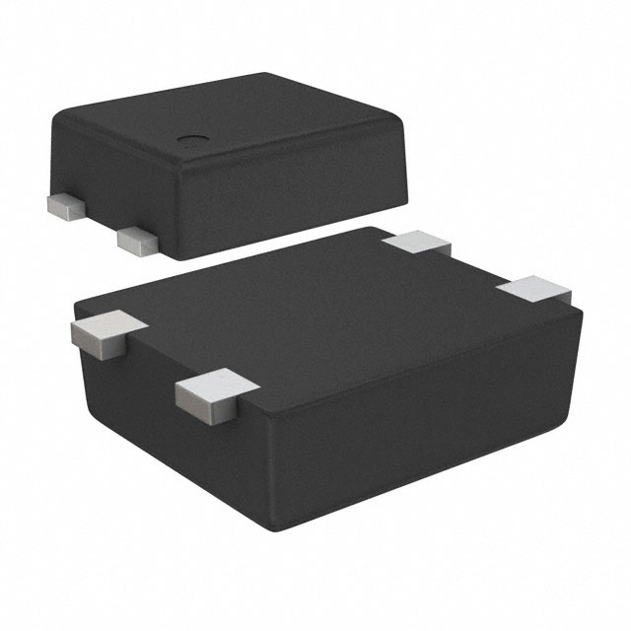
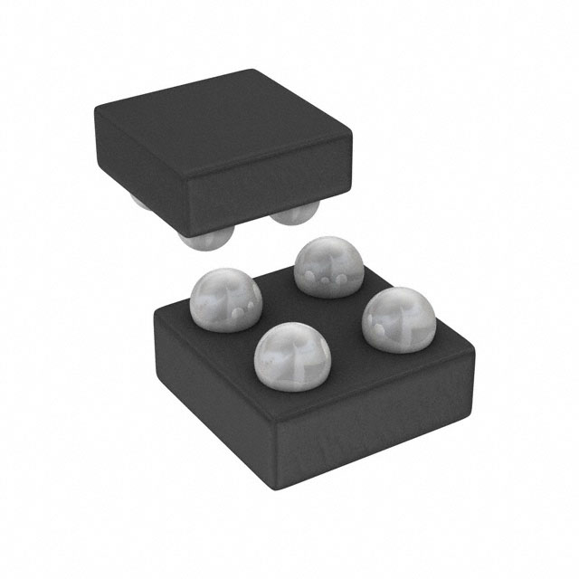
Component selection: power circuit
Reed Switch: ABLIC S-5712A
4 pin, 1.90 mm x 3.00 mm, SNT-4A
Non-contact ‘power switch’
High accuracy hall effect switch IC
$1.07 [X1], 1662-1617-1-ND, LINK
Linear Regulator: Analog Devices ADP172
4 pin, 0.95 mm x 1.03 mm, 4-WLCSP
0.1V dropout voltage
300 mA max current
$1.09 [X1], ADP172ACBZ-3.0-R7CT-ND, LINK
S-5712A
ADP172

Slide 71
Component selection: power circuit
Charging coil: Wurth 760308101219
1 coil, 1 layer, D=15 mm, H=0.6 mm
11.8 uH, 750 mΩ, t = ±10%
$7.43 [X1], 732-9675-ND, LINK
Fuel gauge: TI BQ27621-G1
9 pin, 1.62 mm x 1.58 mm, 9-DSBGA, 0.5 mm pitch
I²C communication
Dynamic voltage correlation algorithm
Battery capacity, state-of-charge, voltage
$2.21 [X1], 296-37460-1-ND, LINK
760308101219
OUT OF SCOPE
BQ27621-G1

Slide 72
Component selection: TBD
Components still need to be selected:
BLE antenna
BLE impedance matching circuit/filter
DCDC circuit

Slide 73
Possible functionality
Possible functionality:
Local data storage? (SD Card, EEPROM, etc…)
Type of ECG connector? (Digikey part number…)
NFC?
Any other ideas?

